Slide 1

Streamlit Workshop
Abdulhadi Zubailah

Slide 2
A faster way too build and share data apps
Streamlit turns data scripts into shareable web apps in minutes. All in pure Python. No front-end experience required.

Slide 3






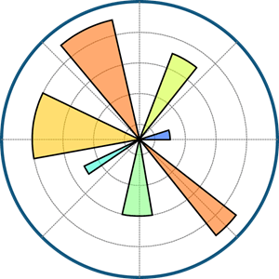

Slide 4



Slide 5
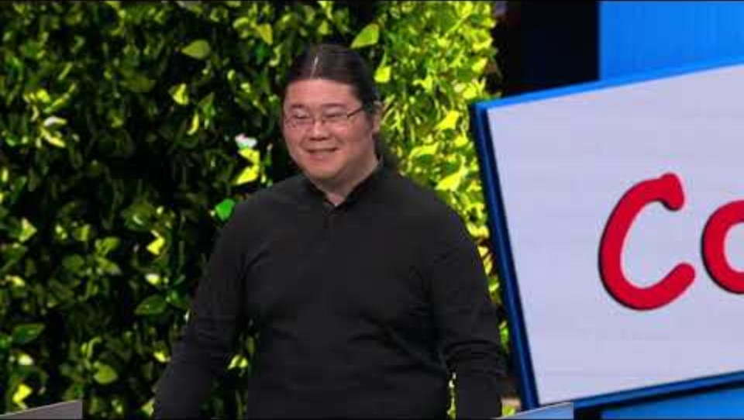

Slide 6
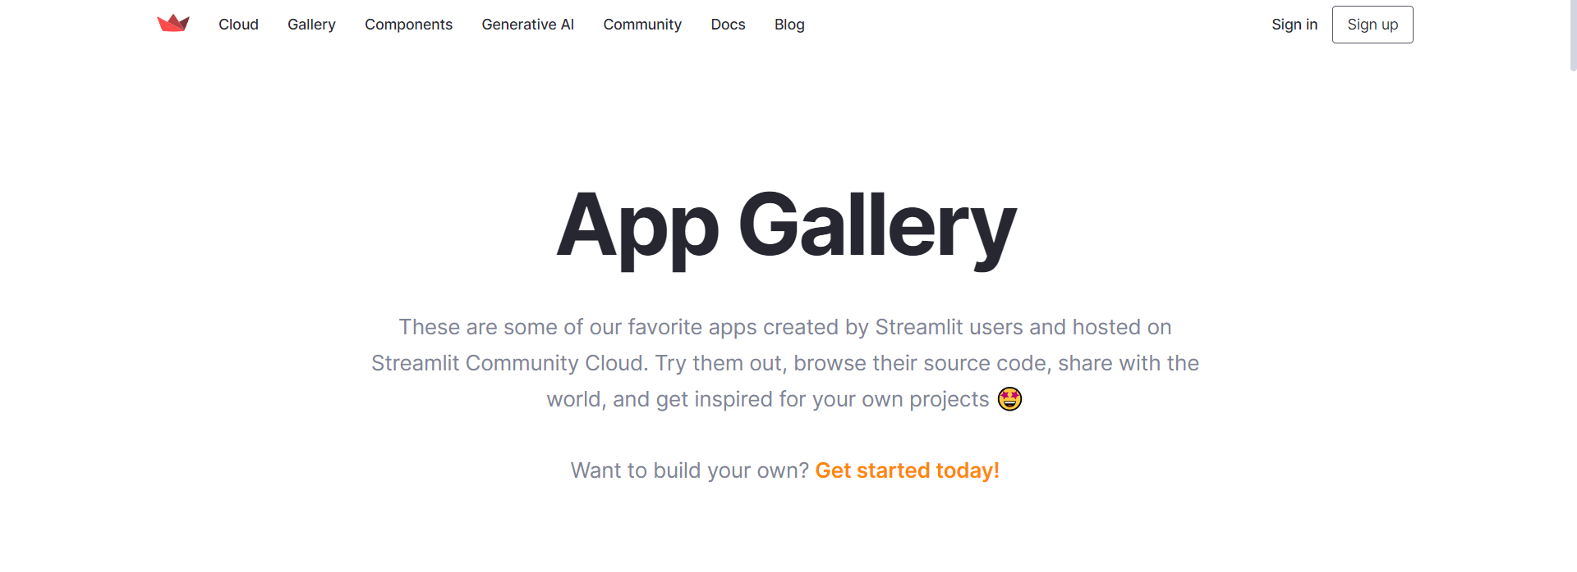

Slide 7
Streamlit Documentation is your best friend

Slide 8
Enough talk… Time to code!

Slide 9
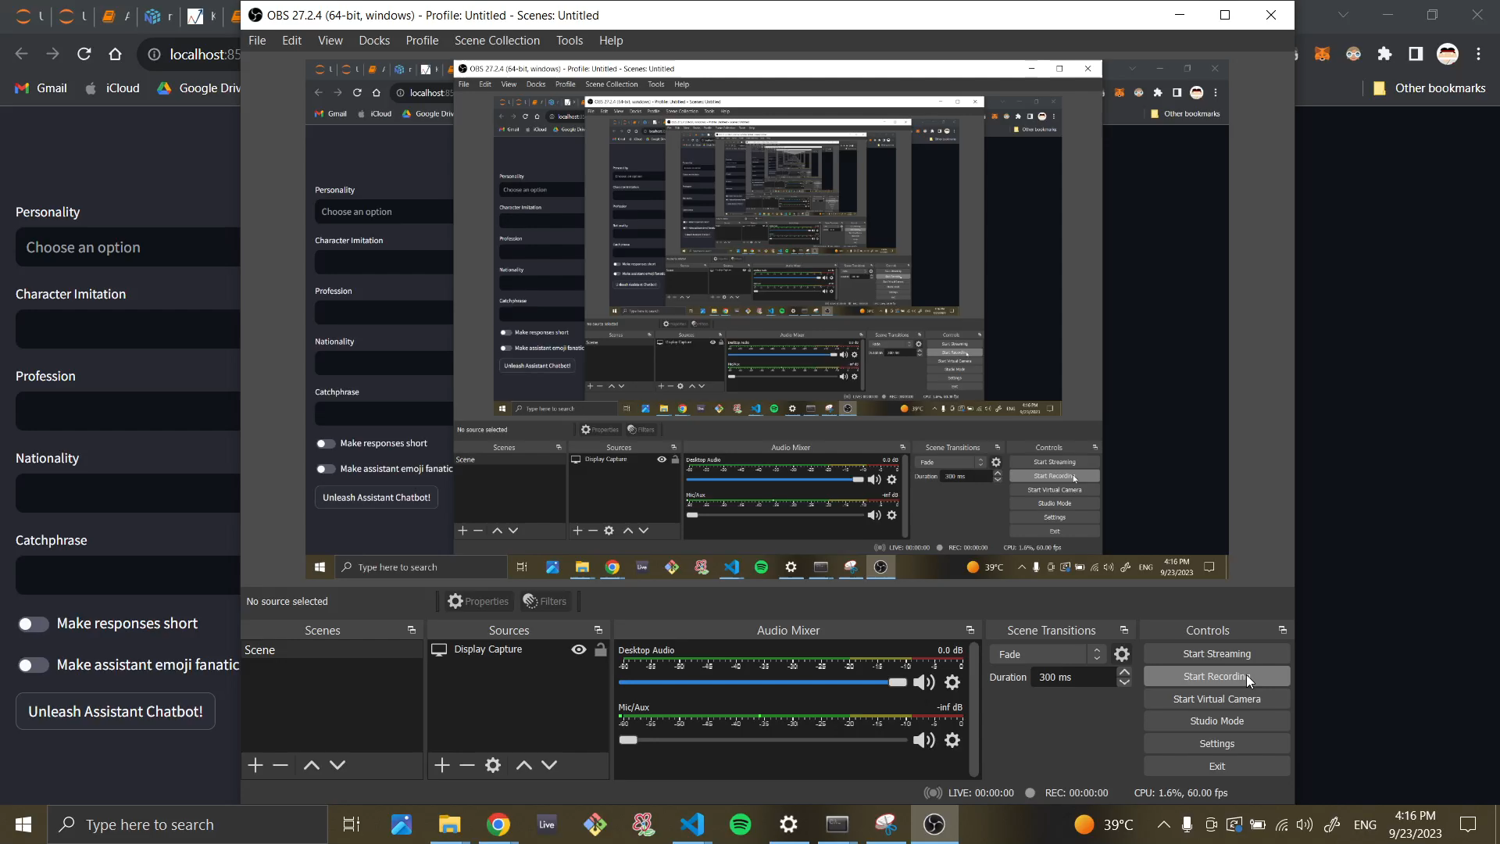
Chatbot Maker Project

Slide 10
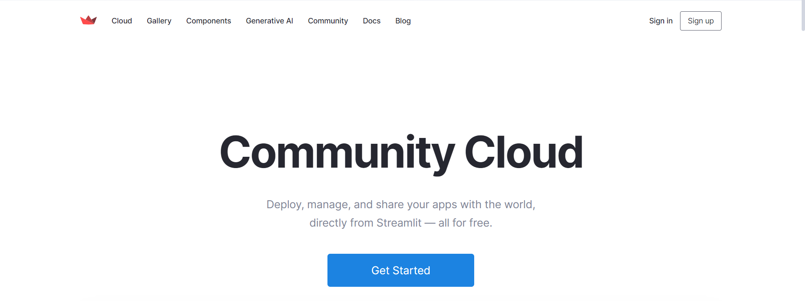

Slide 11
